Slide 1
Machine Learning and Predictive Analytics Final Project: Music Sentiment
Analysis
Alberto Bermea
Search
Home
Library

Slide 2
Problem Statement
Music
Detecting
Music is an important part of our lives, and it is well known that your current mood can be detected by the songs you are listening to, or what you are listening can change your mood.
Using Spotify data, with lyrics and “valence” value that describe the musical positiveness of a song, a high valence means more positive (Happy, Cheerful, euphoric, while songs with low valence means (sad, depresses, angry)
Benefits
Goals
There are a lot of use cases, most likely for Spotify to be able to recommend songs with the same valence values, but there are other use cases like identifying a person with a possible depression that can be treated or prevented
Set a baseline on how to identify a low-valence song, with a deep learning model that can process the words in a song.
Try different approaches to define the best way to calculate the mood of a song.

Slide 3
Assumptions/Hypotheses about data and model
Assumptions
Hypothesis
Lyrics are the only important factor in a song's valence
Valence is correctly calculated by Spotify (given that it is the most popular music streaming)
When trying a classification approach, it will give me better results than when trying a ”linear” result approach
Whichever model is created will not perform ”great” in the sense that valence could be affected by other variables outside of the words themselves (even though we are assuming it is the only important in the Assumptions section we are aware of the limitation in the metrics)

Slide 4
Dataset
158,353
Spotify Information
Artist, Name, Lyric text, and Valence value, this last one calculated by Spotify.
Observations
0 to 1
Valence
This is a float number that goes from 0.0 to 1.0, lower numbers are negative (sadness, angry) , and higher ones are positive (happy, joyful)
Valence
14,691
Kaggle
https://www.kaggle.com/datasets/edenbd/150k-lyrics-labeled-with-spotify-valence
Artist

Slide 5
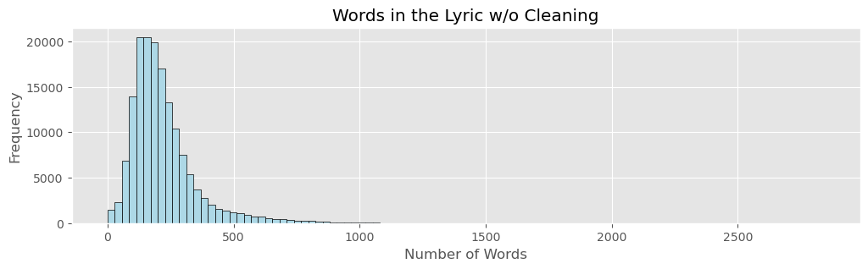
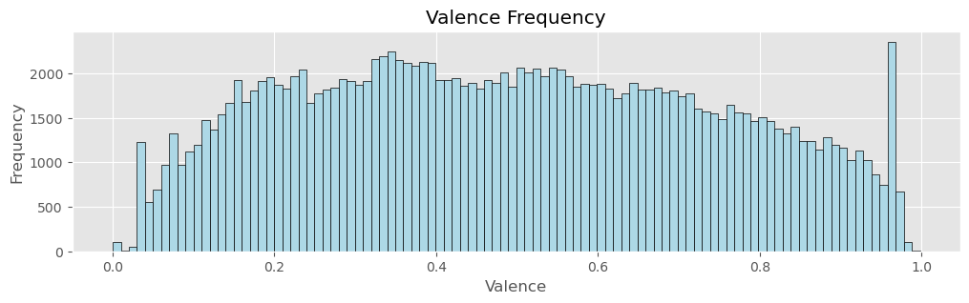
Exploratory Data Analysis
High word count observations, highest “Last Call” by “Kanye West”
Observations with low word count, that could affect the model
The average word count is 220
A considerable amount of the words count are stop words
"Each night I lie in my bed \r\nAnd I think about it \r\nOh my dark friend \r\nCan you give me an answer \r\n\r\nThe people that we love\r\nWe cannot understand \r\nEvery day the people that we love are hurt \r\nThe people who we love \r\nAnd cannot understand\r\nWe cannot understand \r\n\r\nDo you believe we're the children of a God\r\nDo you believe \r\nOr do you believe we're left here all alone\r\nDo you believe \r\n\r\nI have this question\r\nWhat is it for \r\nThis poor life \r\nWe live down here\r\n\r\nIs there a power all above \r\nA person so called God \r\nSo called God \r\nWho plans our life \r\nOr is it our free will \r\nThe creator of our life \r\nAre we responsible \r\n\r\nThe people that we love\r\nWe cannot understand \r\nEvery day the people that we love are hurt \r\nThe people who we love \r\nAnd cannot understand\r\nWe cannot understand \r\n\r\nDo you believe we're the children of a God\r\nDo you believe \r\nOr do you believe we're left here all alone\r\nDo you believe"
The right is one example of a lyric, which has a lot of noise in the sense of:
\r \n \t
Upper letters
Stop words
Lemmatizations
Punctuations
Valence value correctly going from 0 to 1
Not a normal distribution
0.97 being an ”Outlier” bin with the highest count

Slide 6
Feature Engineering & Transformations
Drop duplicated rows | Dropping the same song and the same lyric
Drop outliers and not lyrical song | Z-Score to filter high word count observation Z-Score did not capture lower count observations, manually set the rule to filter observations with 50 words or less
Categorize Valence Float | Negative: 0 < valence < 0.353 Neutral: 0.353 <= valence < 0.619 Positive: 0.619 <= valence < 1 Each category has the same amount of observations
Clean the lyrics | Lower text, eliminate all the “\n” and “\t” as these lyrics were a verse. Remove punctuation Remove Stop words Remove lemmatization of the words (changing every word to the base form (Running -> Run) Drop observations with lyrics not in English.
Tokenize lyrics | We are keeping the 1500 most popular words, and all others are replaced by the token “<OOV>” and tokenized into integers Tokenizer(num_words=1500, oov_token="<OOV>")
Generate sequence | Finally, create a list of 400 integers representing the song in the form of tokens/integers, with the arguments to make sure all the observations are the same length pad_sequences(sequences, maxlen=400, padding='post', truncating='post’)

Slide 7
Proposed Approaches
The proposed approaches are centered around LSTM which is going to be a powerful tool for capturing the dependencies and the contexts of the text sequences.
Linear Problem
Multi Classification Problem
Clean and more Clean
Given the nature of the target variable “Valence” which is a decimal number ranging from 0.0 to 1.0 makes sense to use the first approach was to use Keras Sequential layers with LSTM along with more layers to end up with a decimal number.
Another approach was to classify the “Valence” label, This was done by creating 3 simple classes, “Negative”, “Neutral” and “Positive”
Virtually the same Sequential Layers as the Linear Problem were used, with some changes.
Unfortunately, this approach never achieved good metrics such as accuracy, and there were some serious Overfitting problems, tried to solve this by adding many drop layers, and a low learning rate on the optimizer, in the end, every parameter change made the model overfit without good metrics so it was decided to drop this approach
Not a model, but something that affected the models, after working with the Linear Approach and getting a good starting point, more deep cleaning was done on the text, but to my surprise, the models were not improving much.
This means that no matter if there is a deep clean the models will not perform better compared to lower cleaning in the input text.

Slide 8
Proposed Solution (Linear Approach)
Sequential Layers
Embedding (to reduce the input to a 32-dimensional vector)
Bidirectional LSTM
LSTM as it helps learn the relationship between tokens “words”
Bidirectional so it can process the data in both directions
Dense
To help us reduce and get the final answer
Dropout
2 dropout layers along with a low Learning Rate to avoid overfit and stop too soon
Optimizer
Adam
Learning Rate = 0.00001
A low learning rate with a combination of 2 Dropout layers made the model train for longer improving the MSE before the validation stopped improving and was stopped by Early Stopping
Compile Metrics
Loss: MSE (Mean Square Error)
Metrics: MAE (Mean Absolute Error)
Based on the research and use case when using a linear problem on TF Keras layers these are the metrics to use
Early Stopping
To monitor the value loss and stop the process when the MSE is no longer improving than 0.001 in at least 10 epochs.
Fit/Training
Epoch: 100, although none of the models and test runs more than
Batch _Size = 256

Slide 9
Proposed Solution (Coding Snip)
model.summary()
early_stopping = EarlyStopping(monitor='val_loss',
patience=10,
min_delta=0.001,
verbose=1,
mode='min',
restore_best_weights=True)
history = model.fit(X_train,
y_train,
epochs=100,
batch_size = 256,
validation_data=(X_val, y_val),
callbacks=[early_stopping])
loss, mae = model.evaluate(X_val, y_val)
print(f"Loss: {loss:.3f}, MAE: {mae:.3f}")
list_c4_metrics = ["C4", loss, mae]
pd.DataFrame(history.history).plot(figsize=(12,6))
tokenizer = Tokenizer(num_words=1500, oov_token="<OOV>")
tokenizer.fit_on_texts(data['lyric_clean_4'])
sequences = tokenizer.texts_to_sequences(data['lyric_clean_4'])
padded_sequences = pad_sequences(sequences, maxlen=200, padding='post', truncating='post')
X_train, X_val, y_train, y_val = train_test_split(padded_sequences,
data['valence'],
test_size=0.3,
random_state=42)
model = Sequential([
Embedding(input_dim=1500, output_dim=32),
Dropout(0.5),
Bidirectional(LSTM(32, return_sequences=True)),
Dropout(0.5),
Dense(1, activation='linear')
])
optimizer = Adam(learning_rate=0.00001)
model.compile(loss='mean_squared_error',
optimizer=optimizer,
metrics=['mean_absolute_error'])

Slide 10
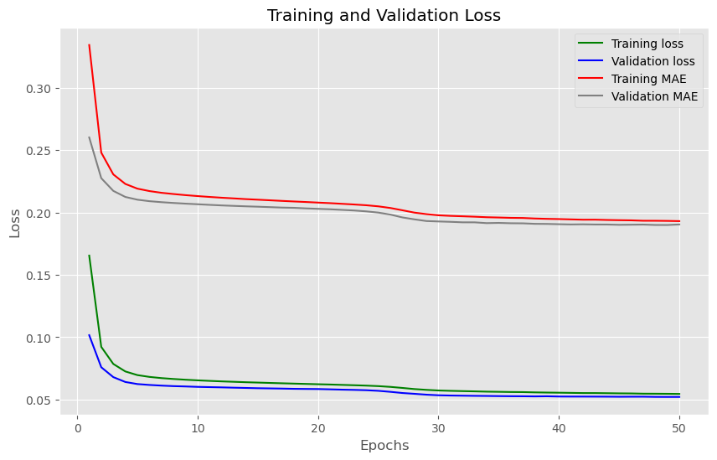
Results & Learnings
Early Stopping best model: 40 epoch
Loss (MSE)
Train: 0.0553
Validation: 0.0524
MAE
Train: 0.1944
Validation: 0.1907
Learnings
This is the first time I had to test a lot of solutions in the sense of moving parameters back and forward, changing one little number on a parameter, like Learning Rate going from 0.0001 to 0.00001 then realizing that this change will be better when also setting another dropout layer.
Using a % of the total available data will save me a lot of hours, something that I learned in Big Data Platforms course.
As well as using only a fraction, dividing and doing data transformations in one notebook and models in another.
I feel like I learned a lot as there was no baseline, or straightforward solution, and I could just think of something I wanted to do and then see how to do it, in a way that I can apply what I learned in the course.

Slide 11
Future Work
As stated in the Assumptions section the lyrics and words of a song are not the only thing that makes what a song is.
To enrich the prediction other variables should be entered into the model to accurately represent the words.
A step beyond and wondering if it is possible is to represent the instruments or musicality of the song that can be seen on a curve graph with volume, bass, etc, and represent this in a 2D space inside the model layers.

Slide 12
Links to code
As stated in the Assumptions section the lyrics and words of a song are not the only thing that makes what a song is.
To enrich the prediction other variables should be entered into the model to accurately represent the words.
A step beyond and wondering if it is possible is to represent the instruments or musicality of the song that can be seen on a curve graph with volume, bass, etc, and represent this in a 2D space inside the model layers.

